Slide 1

Marketing and Retail Analysis – Project 1
Automobile parts manufacturing company
James Kagwe
Masters Program in Data Science and Business Analytics

Slide 2
Problem Statement
An automobile parts manufacturing company has collected data on transactions for 3 years. They do not have any in-house data science team, thus they have hired you as their consultant. Your job is to use your data science skills to find the underlying buying patterns of the customers, provide the company with suitable insights about their customers, and recommend customized marketing strategies for different segments of customers.

Slide 3
Summary of the data:
Objective: The objective of this analysis was to identify the underlying buying patterns of customers, provide insightful information about customer behaviour, and recommend customized marketing strategies for different customer segments.
The dataset consists of 2,747 transactions.
The dataset consists of 20 columns, including 2 float, 6 integer, and 12 object. The data types, provides diverse range of information on the characteristic of the transactions and customers.
The dataset has no duplicate records.
There are no null values in the dataset
Customers on average ordered 35 items per transaction, with a minimum of 6 and a maximum of 97.
The average number of days since the last order is 1,757.09, with a minimum of 42 days and a maximum of 3,562 days.
The average Manufacturer's Suggested Retail Price (MSRP) of the products is $100.69, with a standard deviation of $40.11.
The total sales were 2747 with a maximum of 3562.
Recency, Frequency, Monetary (RFM) analysis constitutes a robust quantitative methodology for profiling and segmenting customers based on their historical purchasing patterns. This technique uses three fundamental dimensions derived from transaction data: the elapsed time since the Recency of the last purchase, the transactional Frequency over a specified period, and the aggregated Monetary expenditure. The resulting customer clusters facilitate the development of customized marketing interventions and the optimization of resource allocation for enhanced customer relationship management (CRM) and retention.

Slide 4

Exploratory Data Analysis
and Inferences

Slide 5
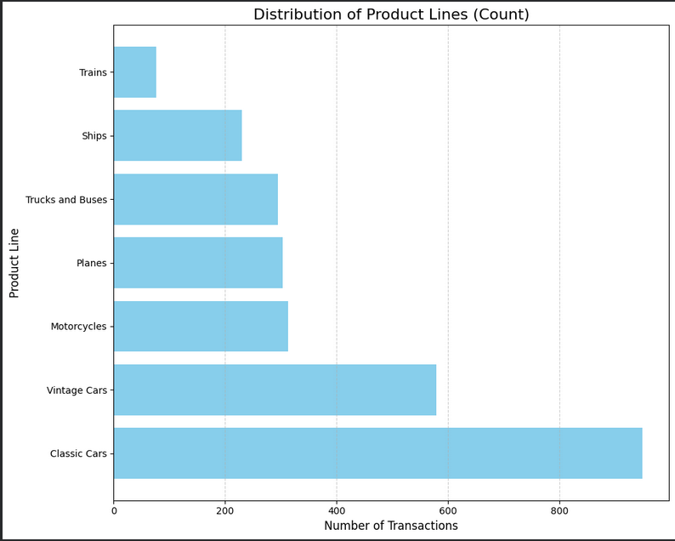
Product Line Analysis
Inferences :
Classic cars and vintage cars are the most popular product lines.
Motorcycles, planes and Trucks and buses follow closely
Trains are trailing

Slide 6
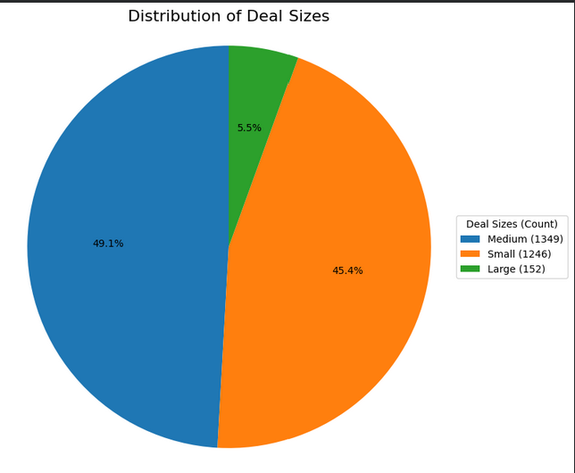
Deal Size Analysis
Inferences :
The majority of the deals fall into the small and medium categories, with counts of 1,246 (45.4%)and 1,349(49.1%), respectively. This indicates that the company mostly engages in transactions of medium to smaller deal sizes.

Slide 7
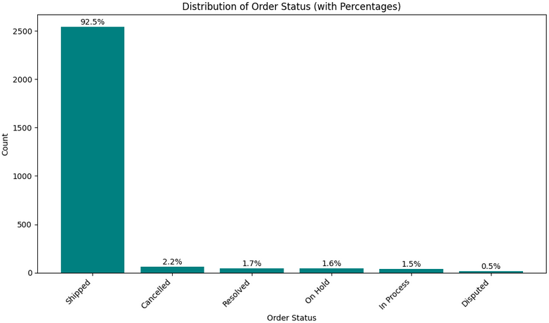
Order Status Analysis
Inferences :
The ability to successfully deliver of 2,541 (92.5%) orders against 2747 placed demonstrates the company's outstanding order fulfilment capabilities and commitment to delivering orders promptly.

Slide 8
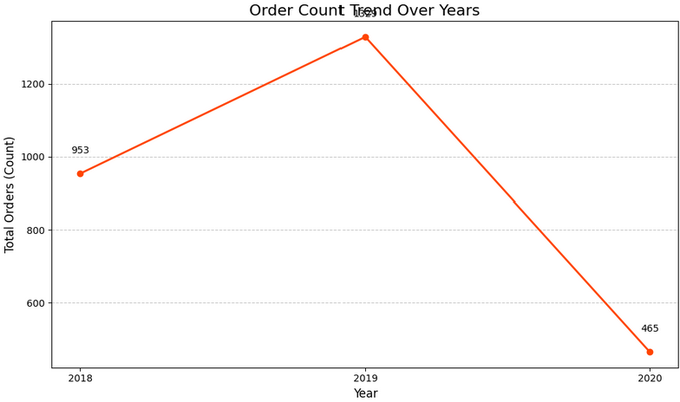
Trend of orders over the Years
Inference:
* Orders showed a positive trend and grew significantly from 2018 (953) to 2019 (1329), suggesting that the business performed well and experienced an increase in customer demand.
* However, since we only have sales data until May for 2020 (465), it is difficult to make conclusive statements about the trend in that year.

Slide 9
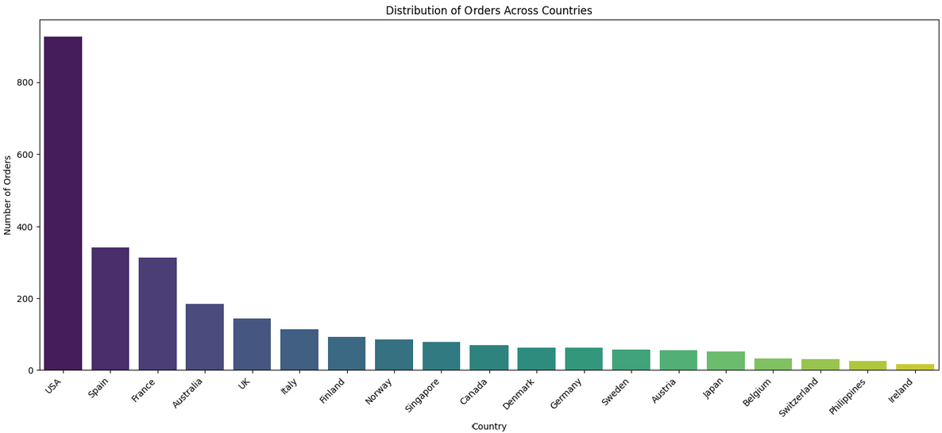
Orders by Country
Inference:
* The orders data by country indicates that the USA (928) has significantly higher orders compared to other countries, suggesting a larger customer base.
* Other countries with many orders include France (314), Australia (185), UK(144),Italy(113) and Finland (92)

Slide 10
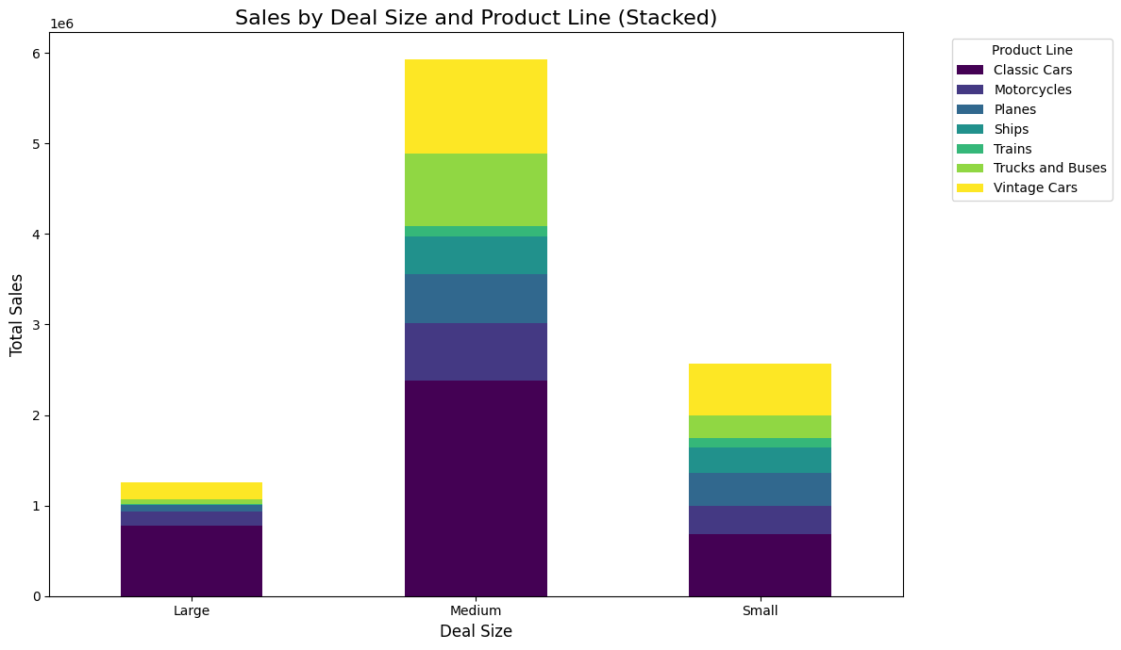
Sales and Deal size by Product line
Inference:
The graph reveals that Classic Cars and Vintage Cars are the most frequently ordered product lines, followed by Motorcycles, Planes, Trucks & Buses, and Ships. In contrast, Trains had the lowest number of orders.
Most orders fell into the medium and small deal size categories for all product lines.

Slide 11
Inferences from Exploratory Analysis (EDA)
Product Line Analysis:
  Classic Cars and Vintage Cars are the most popular product lines.
  Motorcycles, Planes, and Trucks and Buses follow closely in popularity.
  Trains are trailing significantly in popularity and sales volume.
Deal Size Analysis:
  Most transactions fall into the Small (1,246, or 45.4%) and Medium (1,349, or 49.1%) categories.
  This indicates the company primarily engages in medium-to-smaller deal sizes.
Order Status Analysis:
  The successful delivery rate is high, with 2,541 delivered orders (92.5%) out of 2,747 placed.
  This demonstrates the company's outstanding order fulfillment capabilities and commitment to prompt delivery.

Slide 12
Inferences from Exploratory Analysis (EDA) Contd…..
Trend of Orders over the Years:
  Orders showed a positive trend and grew significantly from 2018 (953) to 2019 (1,329), indicating strong business performance.
  Due to having sales data only until May for 2020 (465), it is difficult to make conclusive statements about the full-year trend for 2020.
Orders by Country (Geographic Analysis):
  The USA (928 orders) has a significantly higher number of orders, suggesting a larger customer base.
  Other important markets include France (314), Australia (185), UK (144), Italy (113), and Finland (92).
Multivariate Analysis (Sales and Deal size by Product line):
  Classic Cars and Vintage Cars are the most frequently ordered product lines.
  The majority of orders for all product lines fell into the Medium and Small deal size categories.

Slide 13
Customer Segmentation using RFM analysis
RFM - RFM analysis is a customer segmentation technique commonly used in marketing and retail to analyse and categorize customers based on their purchasing behaviour. RFM stands for Recency, Frequency, and Monetary Value, which are three key metrics used to evaluate customer engagement and profitability.
Core Parameters and Calculation:
  Monetary (M): Represents the revenue generated by each customer.
    Calculation: Price Each × Quantity Ordered.
  Recency (R): Measures how recently a customer made a purchase.
    Calculation: Fixed Reference Date (01-06-2020) - Order Date. (A smaller value indicates higher Recency).
  Frequency (F): Represents how often a customer has made purchases.
    Calculation: Count of Customer Names (i.e., total number of orders).
Customer Segmentation (Auto-Binning):
  Customers are grouped into four distinct categories based on their RFM scores:
    High
    Moderate
    Low
    Very Low
These parameters are utilized in RFM analysis to evaluate customer behaviour, identify customer segments, and make data-driven marketing and sales decisions.

Slide 14
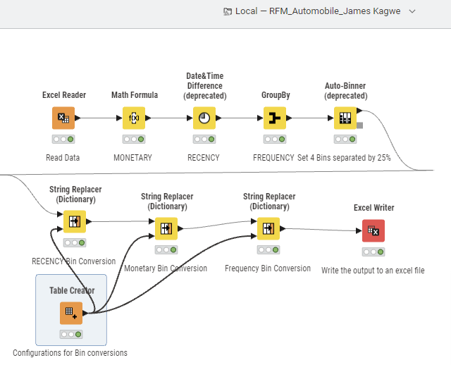
KNIME Workflow

Slide 15
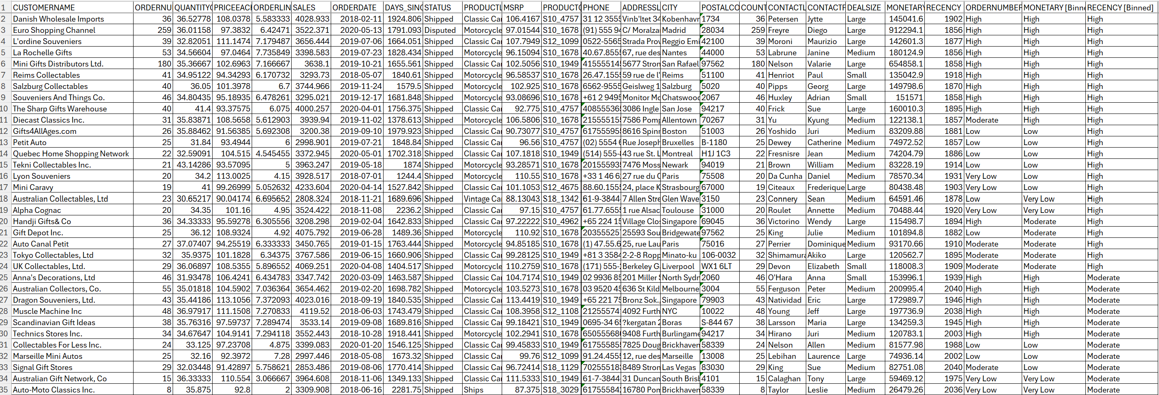
Output Table

Slide 16
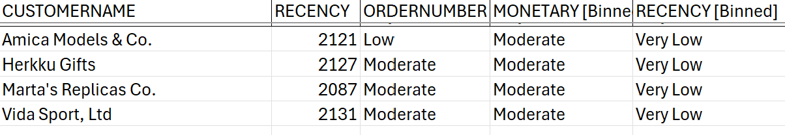
Customers at the Risk of Churning

Slide 17
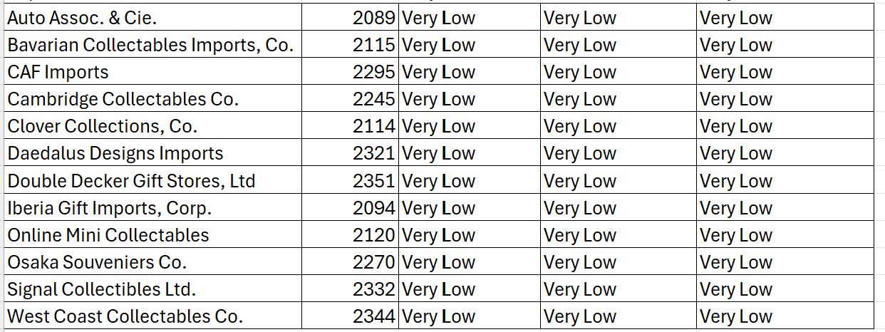
Top 10 Lost Customers

Slide 18
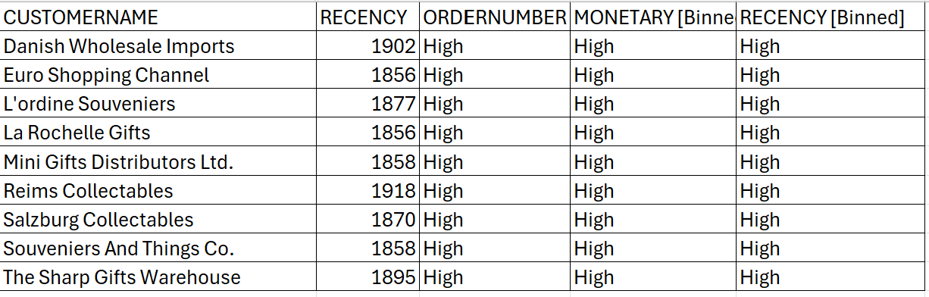
Top 10 Royal Customers

Slide 19
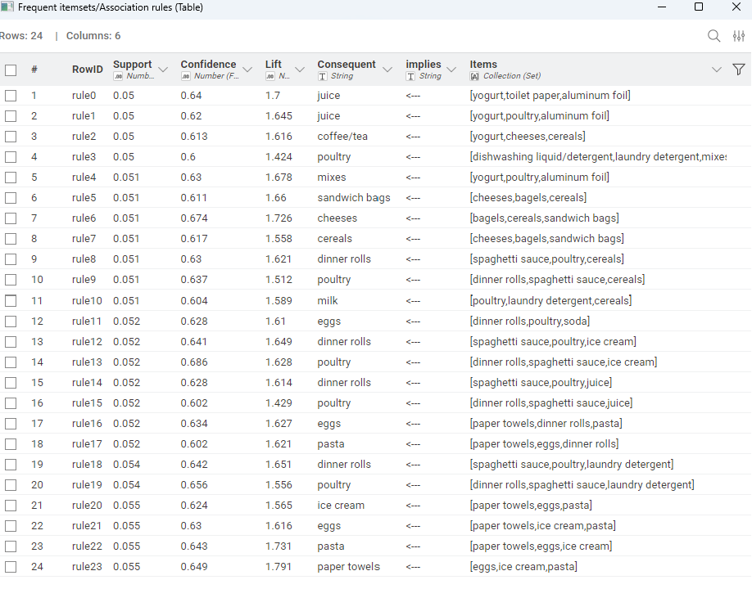
Market Basket Analysis- Frequent Items Association Rules

Slide 20
Conclusions
Product & Deal Value Dependency
Core Products: Classic Cars and Vintage Cars are the two most popular and frequently ordered product lines.
Value Gap: The company relies heavily on Small (45.4%) and Medium (49.1%) deal sizes, which together account for over 94% of transactions. This indicates a significant opportunity to increase the value of Large deals (only 5.5% of the total).
Operational Strength & Market Focus
Fulfillment Reliability: The company exhibits outstanding order fulfillment capabilities, successfully shipping 92.5% of all 2,747 placed orders.
Geographic Concentration: The USA is the largest market, accounting for 928 orders, which is significantly higher than the next leading countries (e.g., France at 314).
Order Trend: Orders showed strong, positive growth from 2018 (953) to 2019 (1,329). However, the 2020 trend is inconclusive due to limited data (only 465 orders through May).
Customer Segmentation Insights (RFM)
The auto-binning RFM analysis successfully segmented customers into value-based groups:
Royal Customers: A segment of Top 10 Royal Customers (e.g., Danish Wholesale Imports, Euro Shopping Channel) are identified as being High in Recency, Frequency, and Monetary value, representing the company's most profitable segment.
Churn Risk: Specific accounts are categorized as Customers at Risk of Churning (e.g., Amica Models & Co., Herkku Gifts) due to very low Recency (2,000+ days) and Moderate Frequency/Monetary scores, requiring immediate attention.
Lost Customers: A group of Top 10 Lost Customers (e.g., Auto Assoc. & Cie.) have been identified as having Very Low scores across all RFM parameters, suggesting minimal resource should be spent on re-engagement.

Slide 21
Recommendations
1. Strategy for Revenue Growth (Monetary Value)
Upsell Medium Deals to Large:
Action: Implement tiered loyalty or bundling offers that are only accessible when the order value exceeds the threshold for a Large Deal.
Focus: Target customers who regularly place Medium orders with curated, high-value packages, especially combining Classic and Vintage Cars with premium accessories.
2. Cross-Promote Trailing Products:
Action: Use the high demand for Classic Cars and Vintage Cars to run targeted cross-sell campaigns for the low-performing Trains product line.
Offer: Provide an exclusive discount on a Train model when a customer purchases a new Classic Car or Vintage Car.
3. Customer Retention Strategies (RFM Segments)
Reward Royal Customers (High/High/High):
Action: Prioritize customer service and rewards over discounts.
Implementation: Introduce a premium loyalty tier offering exclusive benefits such as early access to new product launches, dedicated account management, or complimentary premium shipping (leveraging the company’s excellent fulfillment record).

Slide 22
Recommendations Contd……
4. Win-Back At-Risk Customers:
Action: Immediately launch personalized email and direct mail campaigns to the Customers at Risk of Churning.
Message: Use the company’s 92.5% successful delivery rate as a key selling point in the communication, assuring them of reliable service.
Offer: A high-value, time-sensitive incentive (e.g., 20% off their next purchase) to drive immediate Recency.
5. Optimize Lost Customer Spend:
Action: Direct the majority of marketing budget away from the Top 10 Lost Customers.
Implementation: Limit communication to low-cost, automated annual check-ins, reserving resources for higher-potential segments (Royal and At-Risk).
6. Geographic & Trend Strategy
USA Market Deep Dive:
Action: Continue high investment in the USA market to capitalize on the largest customer base. Focus on increasing the Frequency and Monetary value within this market through retargeting and loyalty programs.
International Growth:
Action: Deploy targeted, cost-effective digital marketing campaigns in secondary high-order countries like France, Australia, and the UK. Focus promotional content on the most popular products (Classic and Vintage Cars) tailored to local currency and cultural context.

Slide 23



